Slide 1
Pirate Dash
By Nadia Nadeem

Slide 2
Task Aims
To create a 2D Boat Race based on a specific theme specified in the assignment brief. The theme chosen was pirate based.
The game needed to include:
Continuous scrolling background.
Boat can move forwards, backwards and rotate left and right.
UI with player lives, health, score and a timer.
Boat animations.
Playable with a third-party controller or keyboard.
Two randomly timed obstacles with penalties.
Two unique rewards.

Slide 3
Approach
As seen in Figure 1 a sketch was created to help with the layout of the game and problem decomposition.

Slide 4
Controls
W, A, S, D keys.
An Xbox One controller can be used. The left joystick is used to move the boat up and down and the right joystick is used to rotate left and right.

Slide 5
How To Play
The player has to dodge obstacles and try to get coins to increase the score. The longer the timer goes on the more of a bonus the player gets to the score.
Obstacles take away health from the player.
Once the player’s health hits 0 a life is taken away from the player.
When the player is out of lives the game ends and the score bonus is added.

Slide 6
Playtesting
During internal playtesting it was revealed that obstacles were not spawning enough so I decreased the frame rate in-between obstacles spawning.

Slide 7
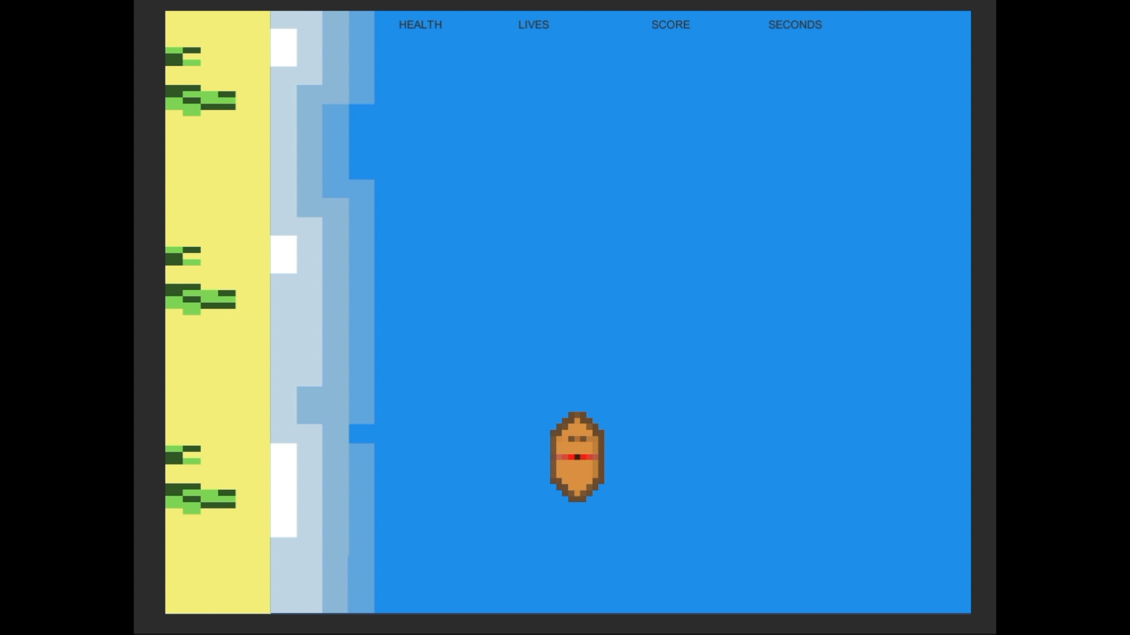
Video

Slide 8
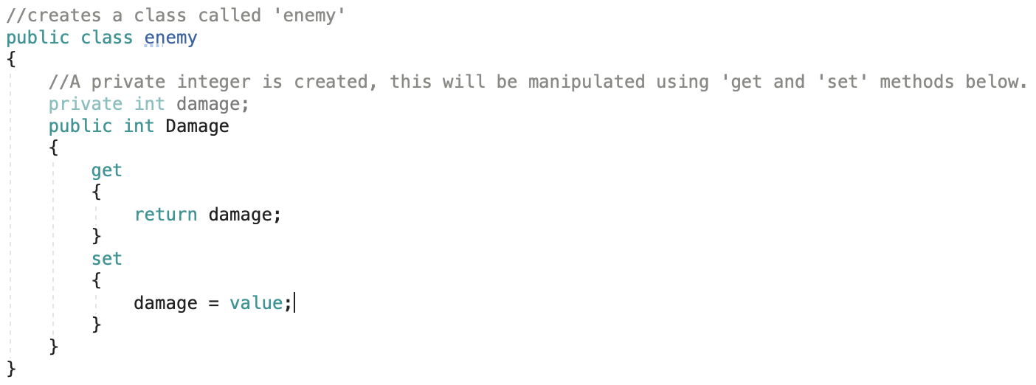
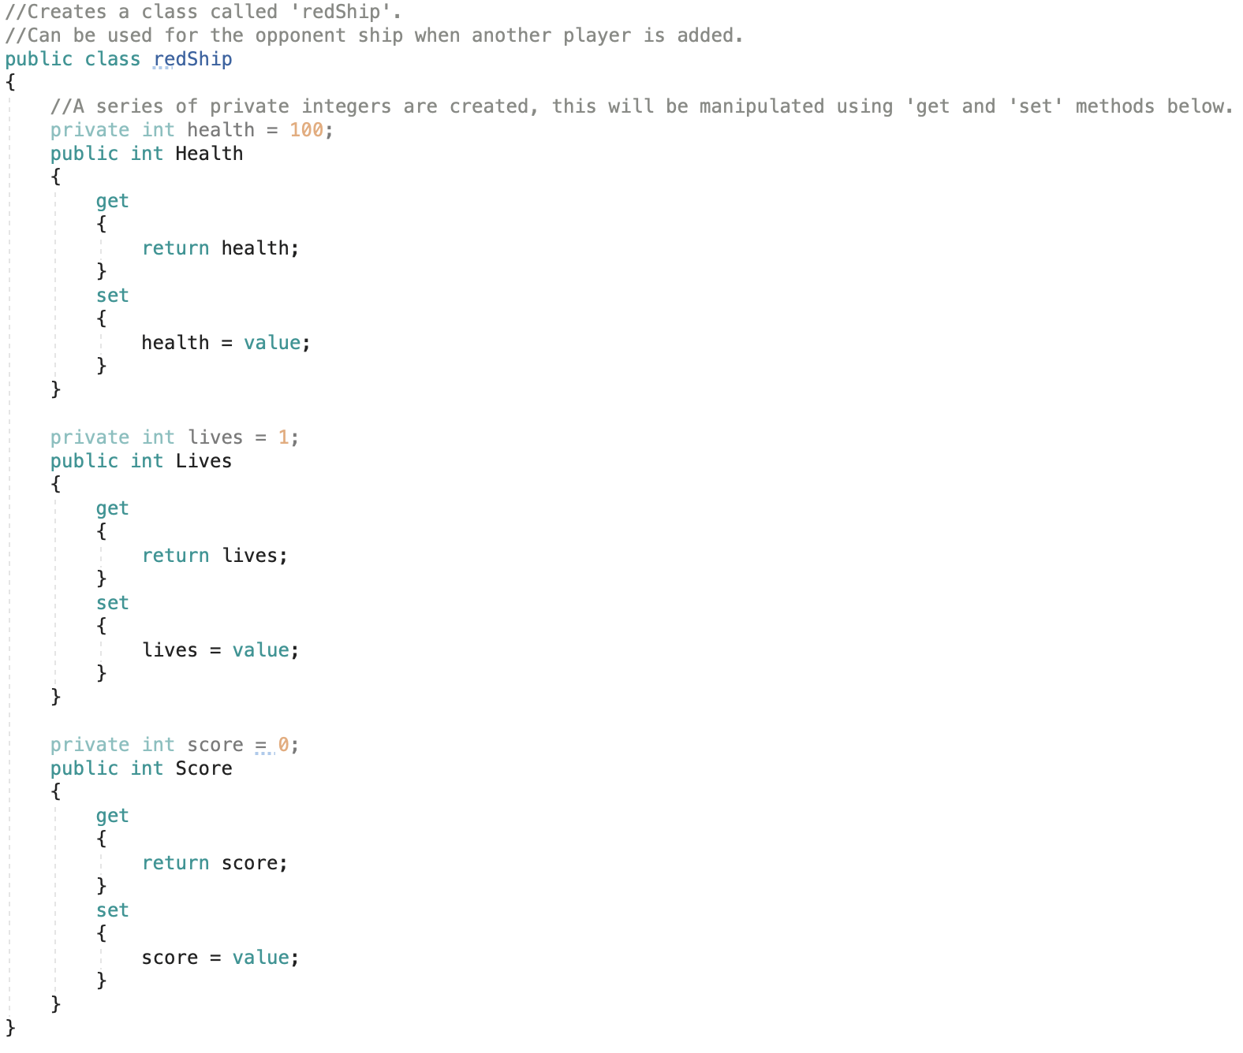
Custom Classes
Custom classes were created for the obstacles and for the player.

Slide 9
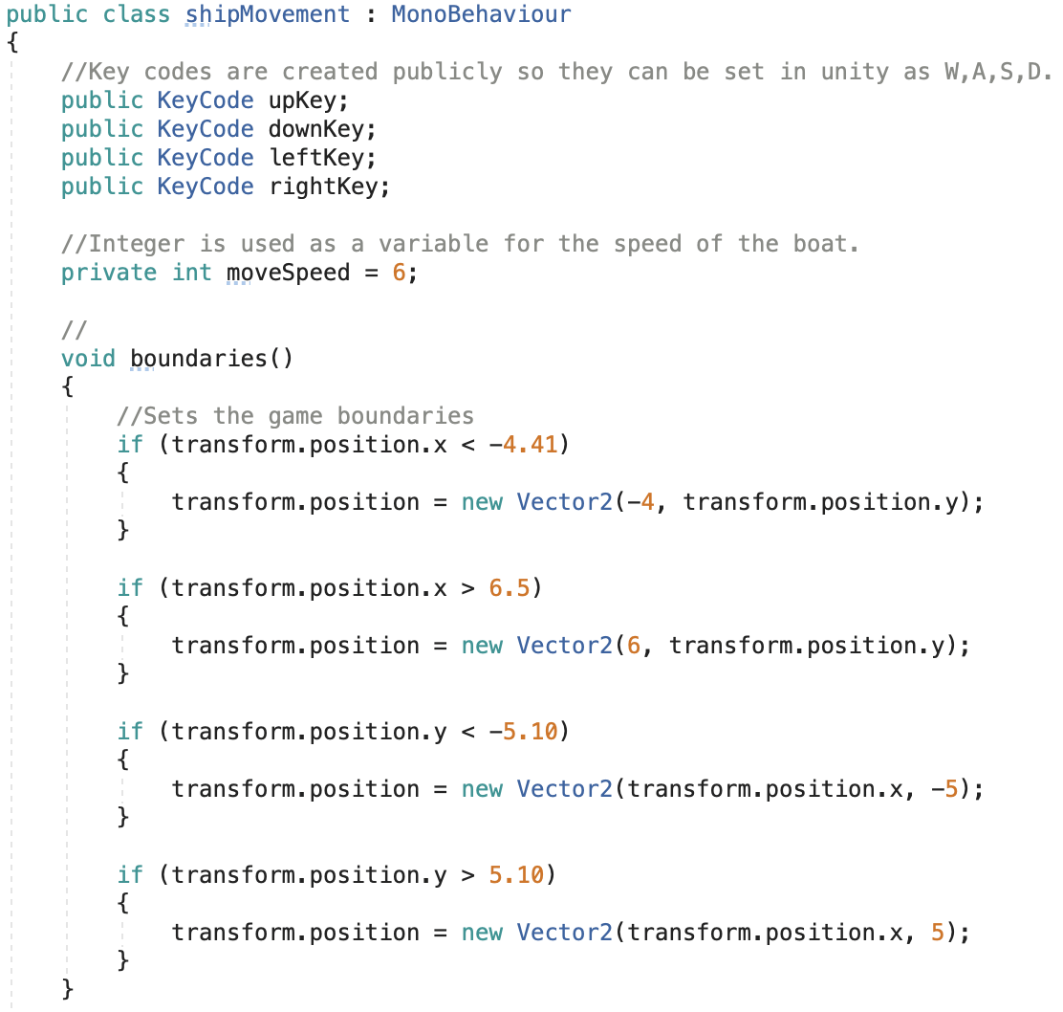
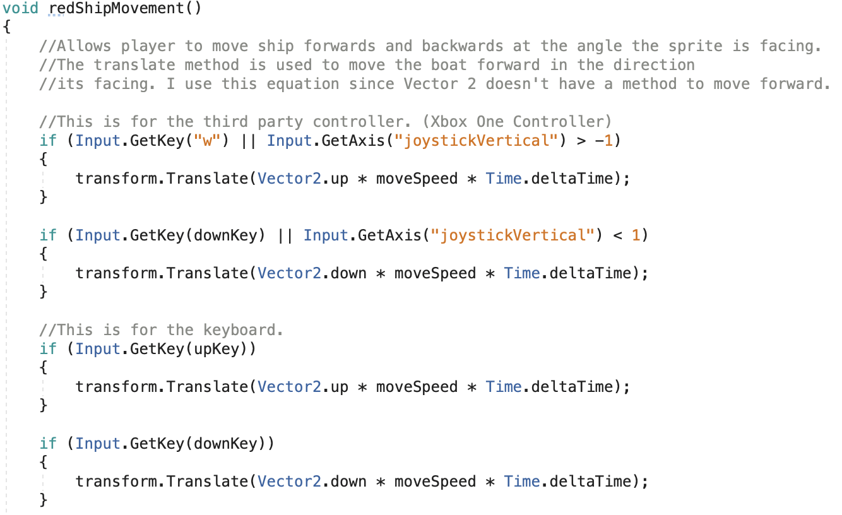
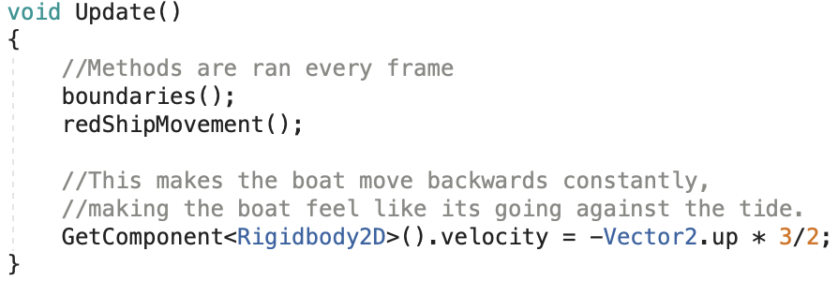
Ship Movement

Slide 10
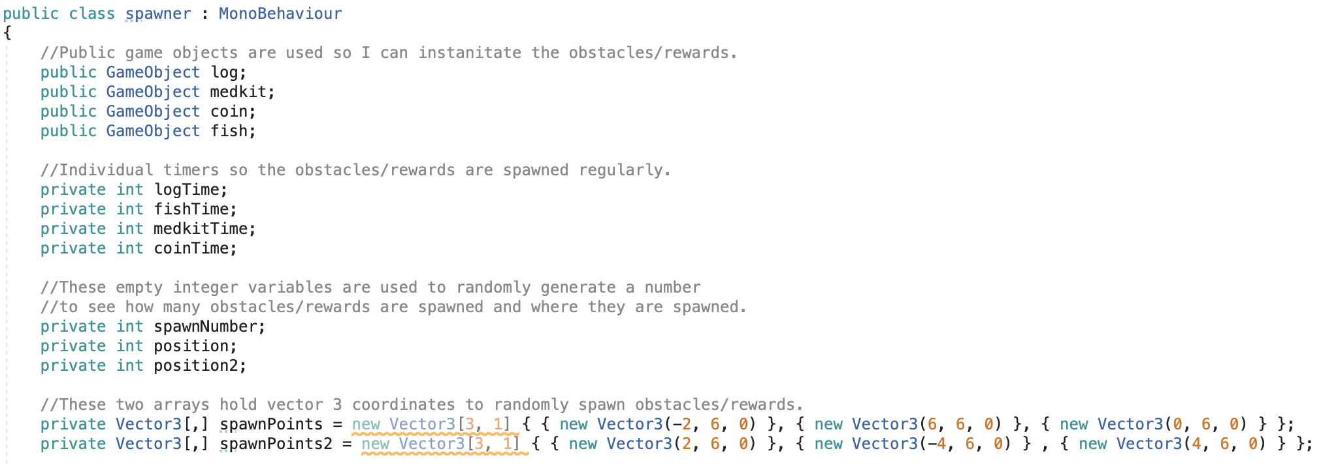
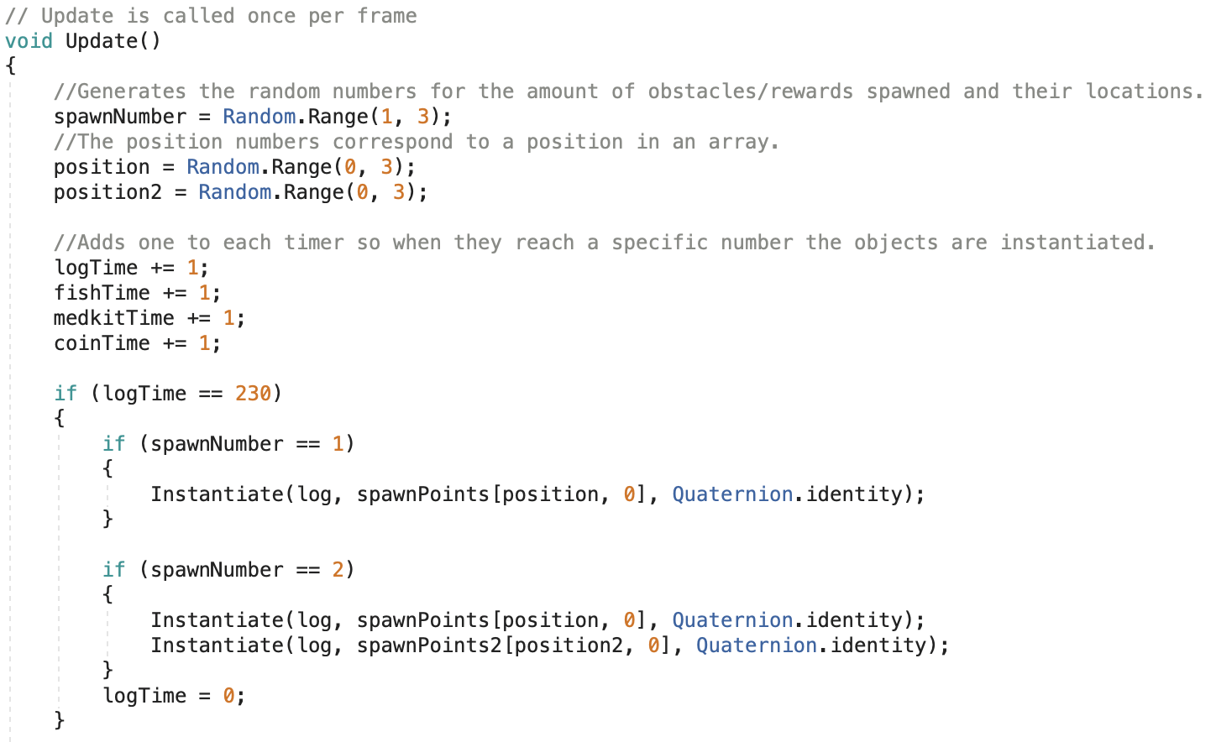
Spawner

Slide 11
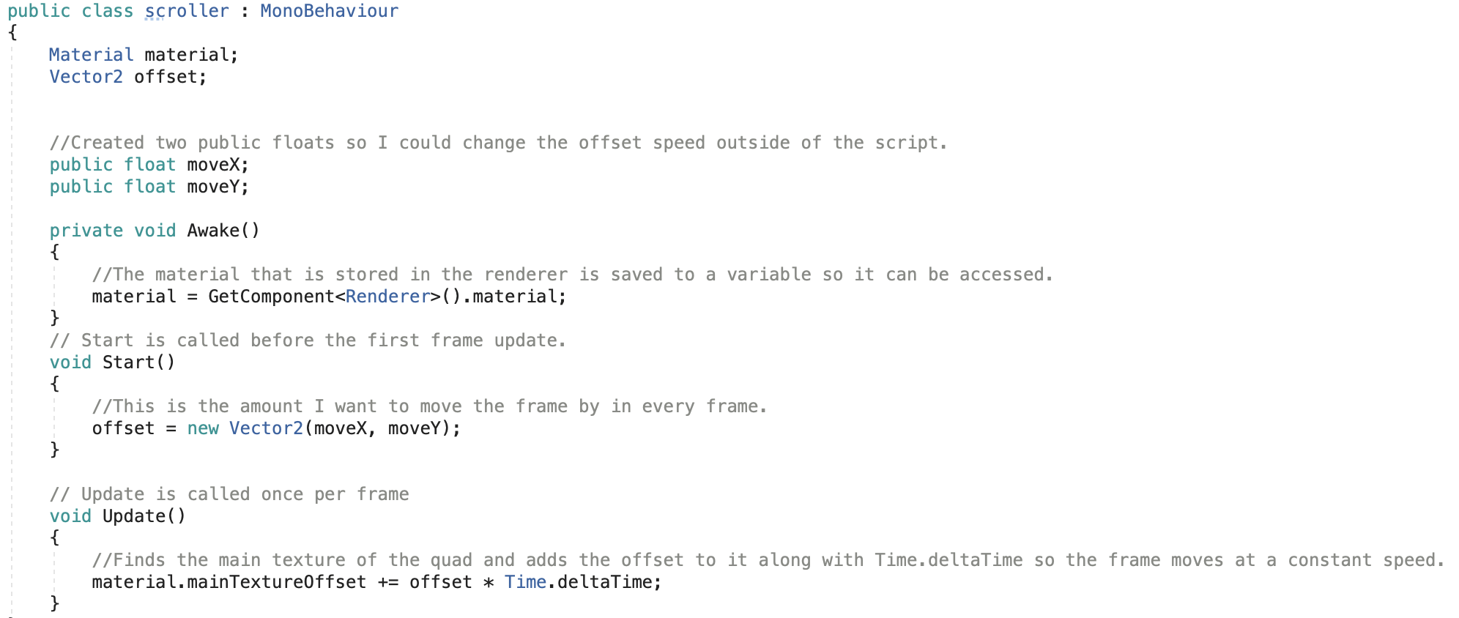
Scroller

Slide 12
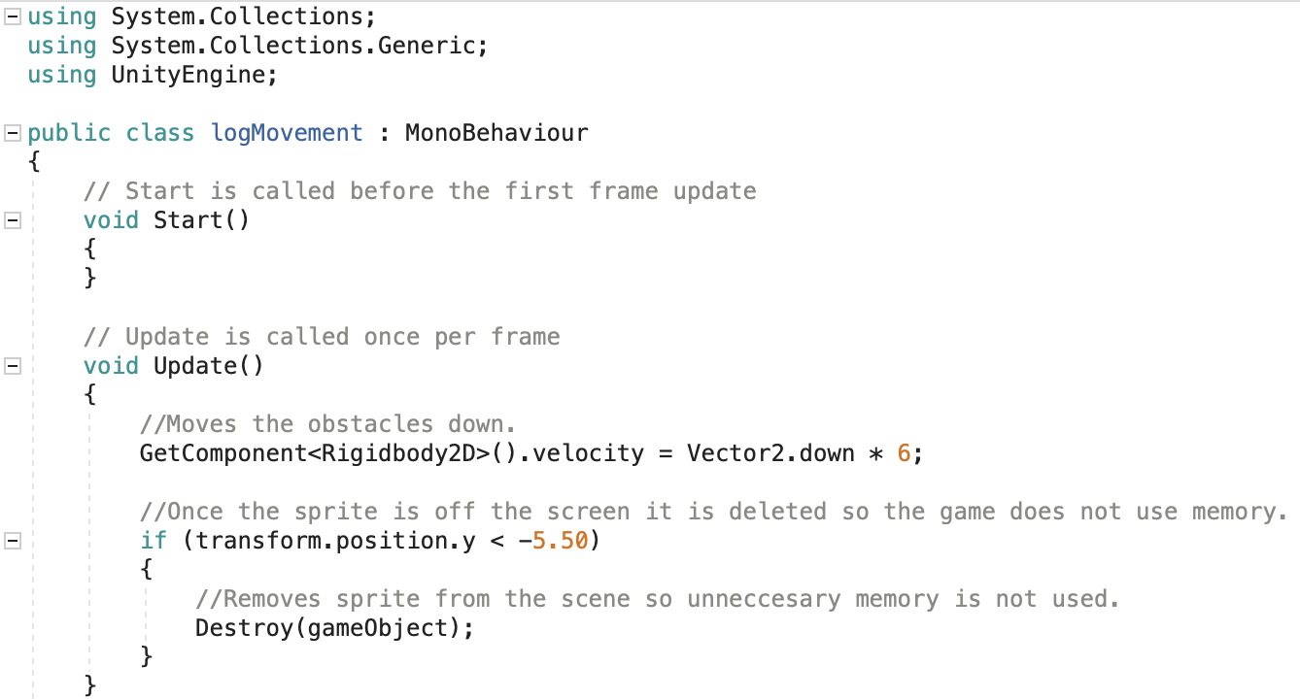
Movement for obstacles/rewards.

Slide 13
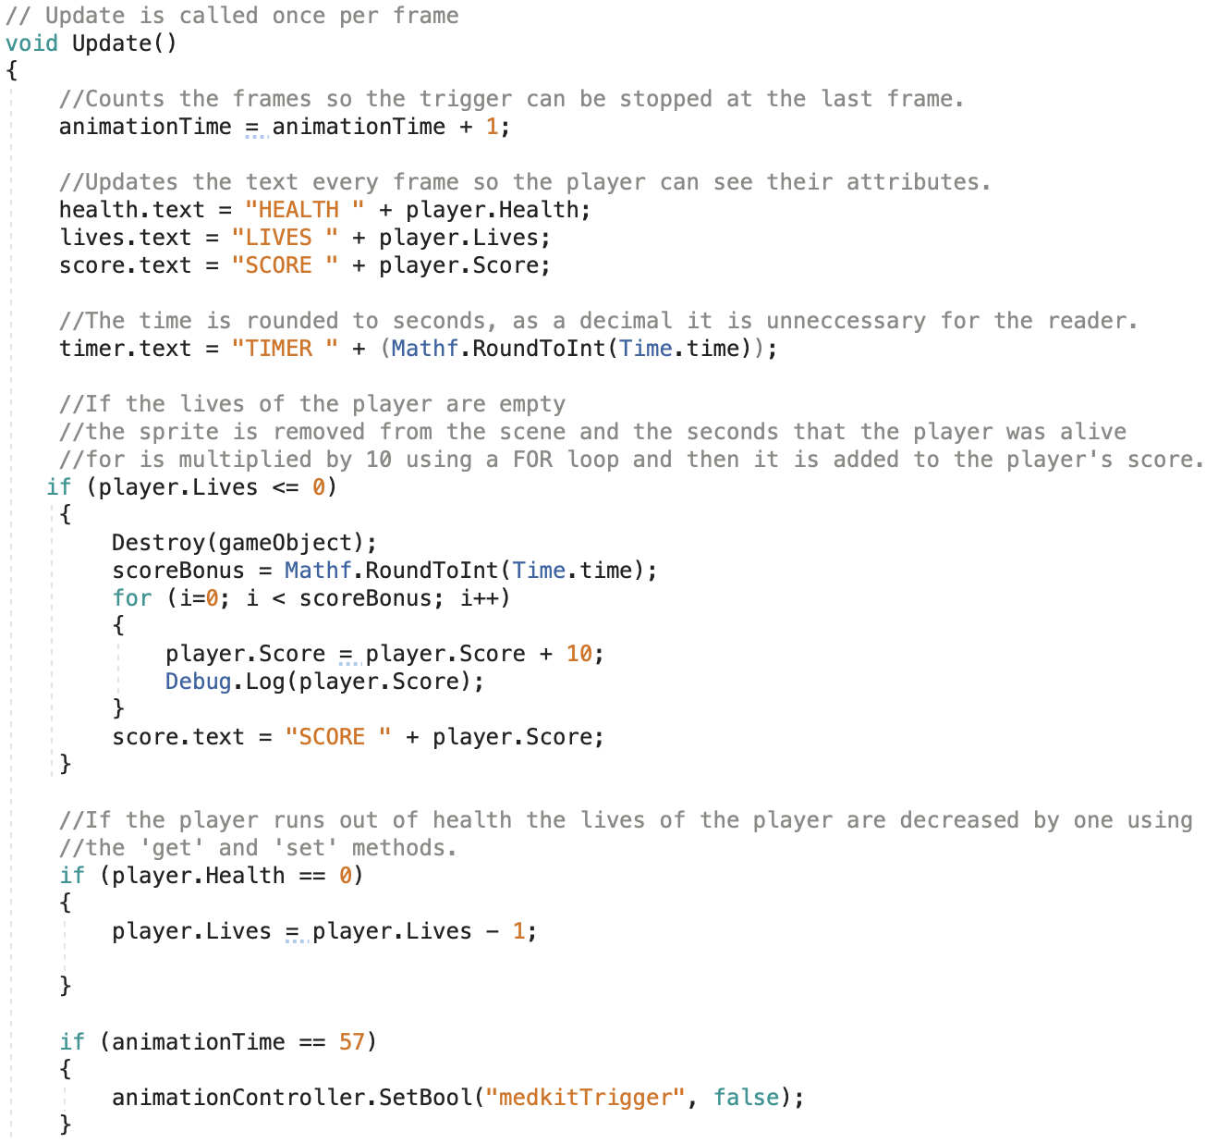
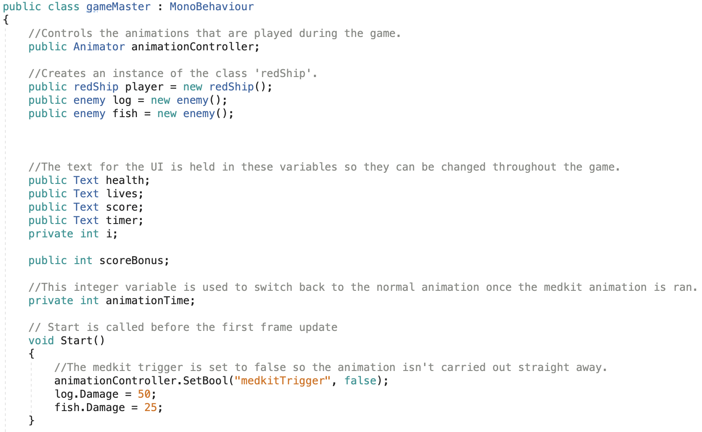
Game Master

Slide 14
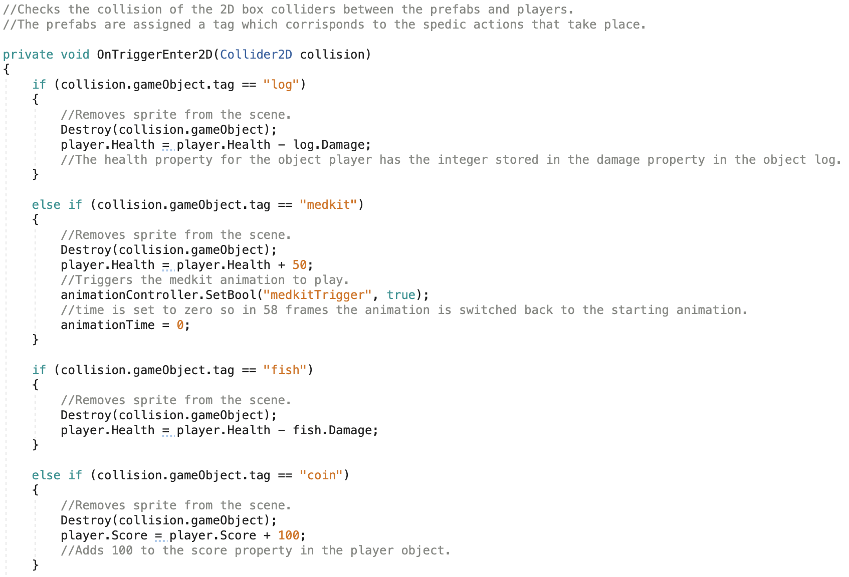

Slide 15
References
Creating a Continuous Scrolling Background: https://www.youtube.com/watch?v=epRPKFsOPck
Xbox Controller Inputs: https://www.bing.com/videos/search?q=xbox+controller+input+unity&view=detail&mid=461D1E7EAD29C617DA98461D1E7EAD29C617DA98&FORM=VIRE
Animation Switching: https://www.youtube.com/watch?v=HVCsg_62xYw

